Slide 1
Searching Overdrive & Managing your Digital Account
Using a Computer
Prepared by the Computer Lab
Montgomery County-Norristown Public Library
July 2014

Slide 2
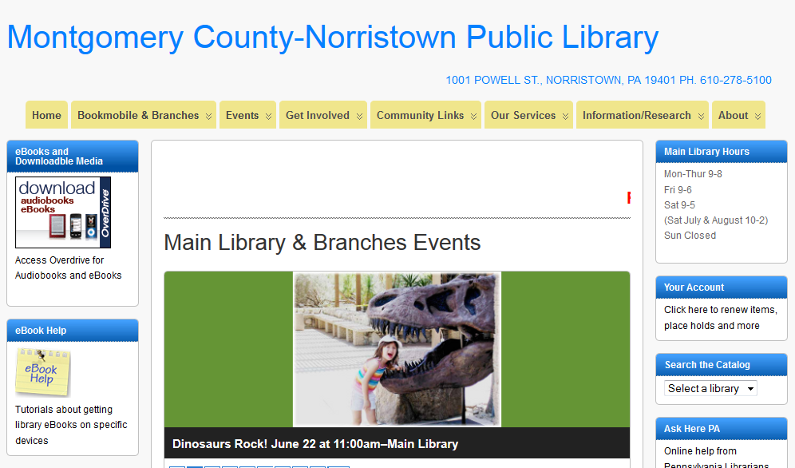
On a computer:
Open a browser
go to www.mc-npl.org
click on the link to download audiobooks/eBooks
Notes:
To search our digital collection, begin by going to our website and clicking on the download audiobooks/ebooks link.

Slide 3
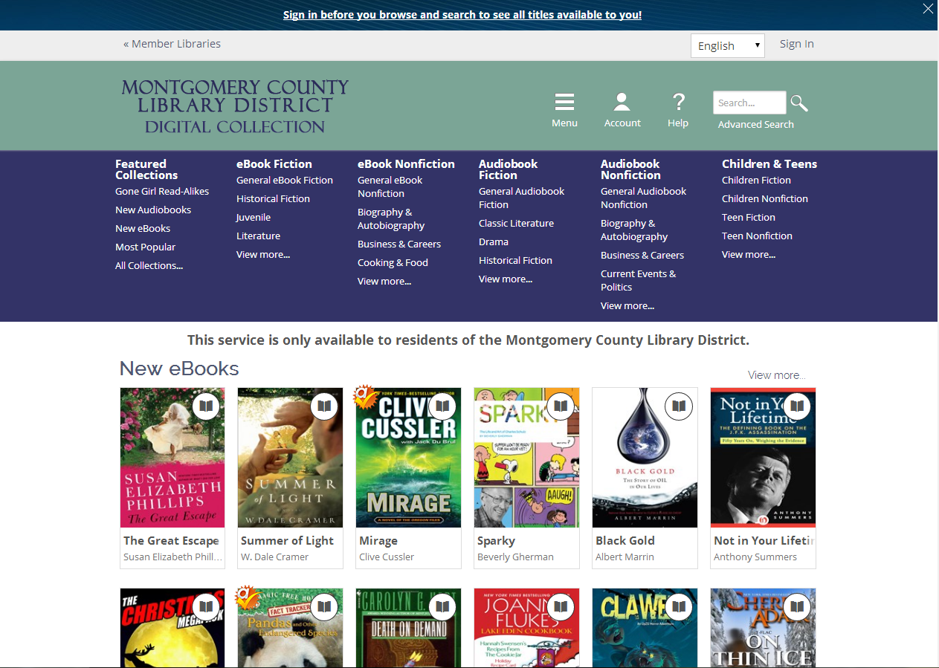
You will be taken to the Home page for the Montgomery County Library District’s Digital Collection (sometimes referred to as the OverDrive website).
Notes:
You will be taken to the home page for Montgomery County Library District’s Digital Collection.

Slide 4
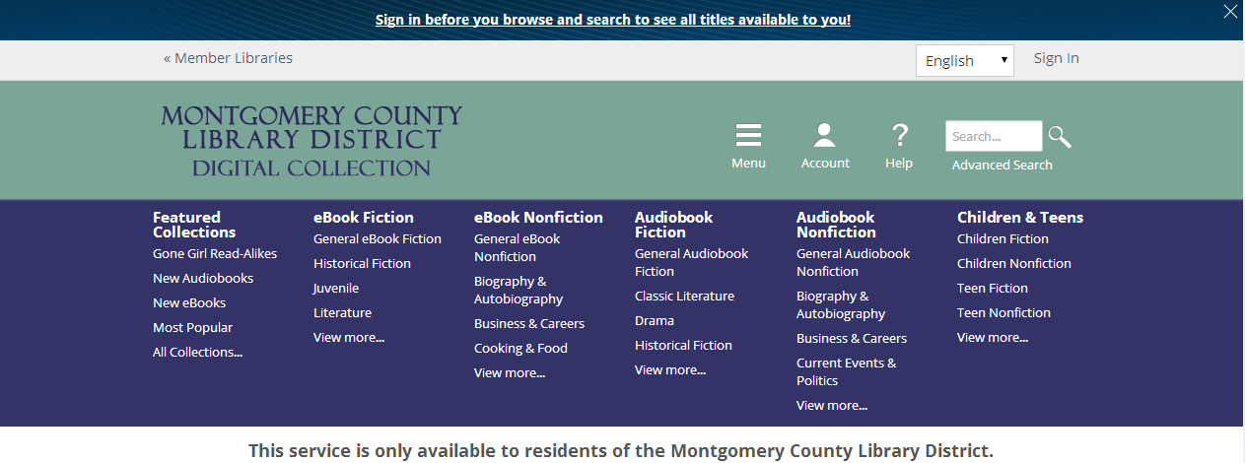
Link to list of member libraries which includes website links
OverDrive recommends signing in to your OverDrive account first. This is a link to the sign in screen.
Another Sign In link
Clicking these words will always take you to the home page.
Notes:
You will be taken to the home page for Montgomery County Library District’s Digital Collection.

Slide 5
Clicking Menu collapses dark blue section beneath.
Search box
Help
Clicking Account prompts you to sign in if you haven't already.
Advanced Search
Links to categorized breakdown of digital collection
Notes:
You will be taken to the home page for Montgomery County Library District’s Digital Collection.

Slide 6
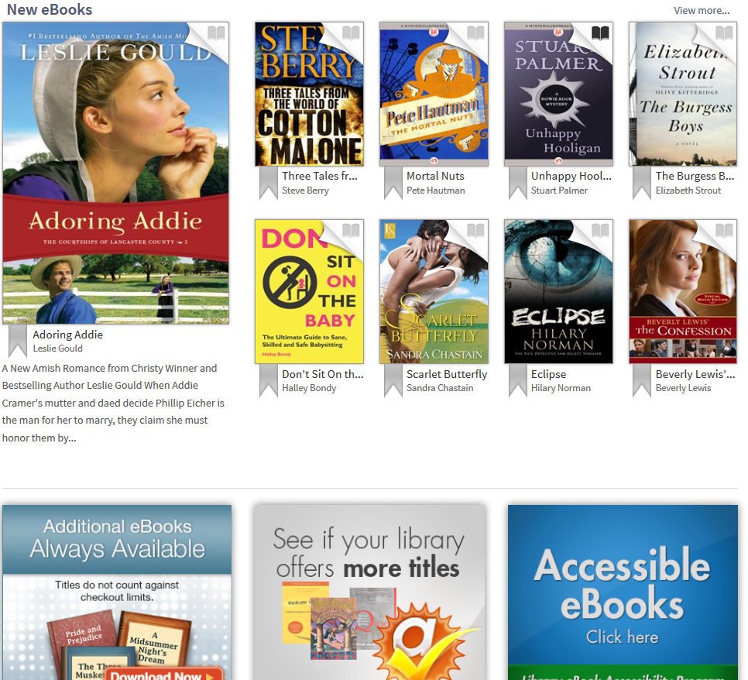
Scroll down to see bottom section. The material in the featured collections are displayed in more detail. New eBooks are featured on top.
This section calls out links for Books Always Available (Public Domain Books), Advantage Libraries, and Accessible eBooks.
Notes:
You will be taken to the home page for Montgomery County Library District’s Digital Collection.

Slide 7
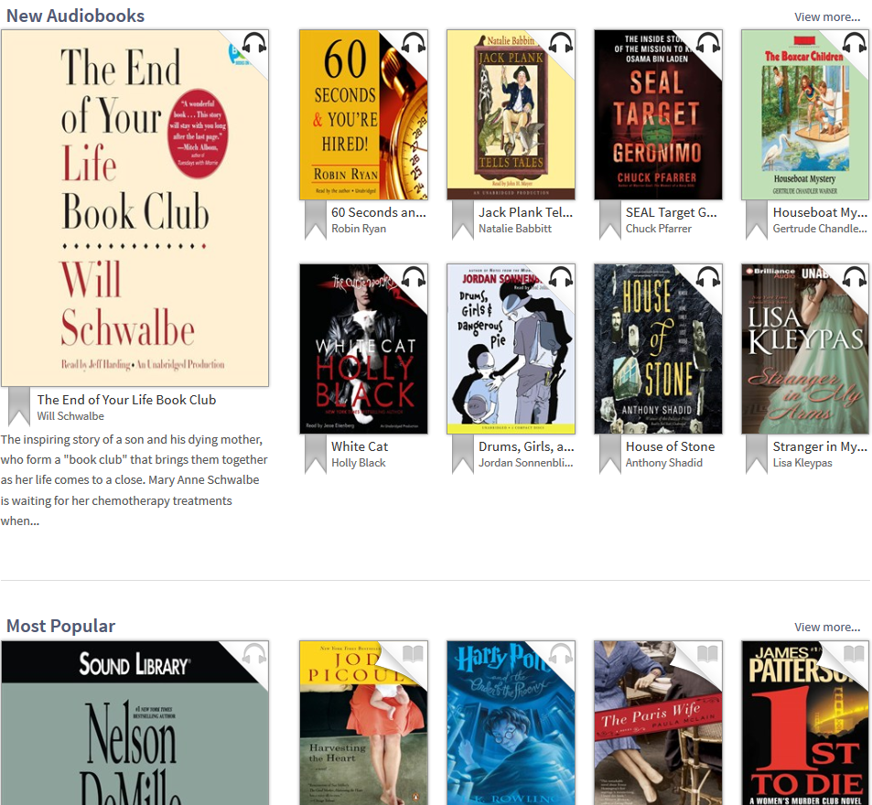
Scrolling down further reveals additional collections:
New audiobooks,
Most Popular (includes both audio and e Books)
Lost in the Stacks (includes both audio and e books
Notes:
You will be taken to the home page for Montgomery County Library District’s Digital Collection.

Slide 8
We are going to start browsing for eBooks. The first step is to Sign In to OverDrive.
Notes:
You will be taken to the home page for Montgomery County Library District’s Digital Collection.

Slide 9
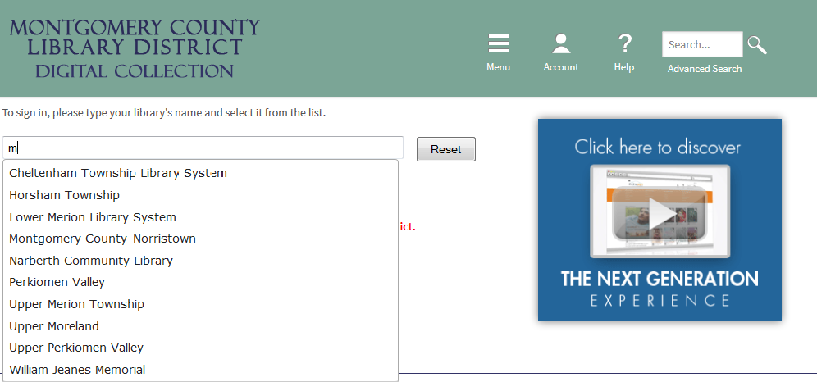
Start typing the name of your library and select it from the list that drops down.
Notes:
You will be taken to the home page for Montgomery County Library District’s Digital Collection.

Slide 10
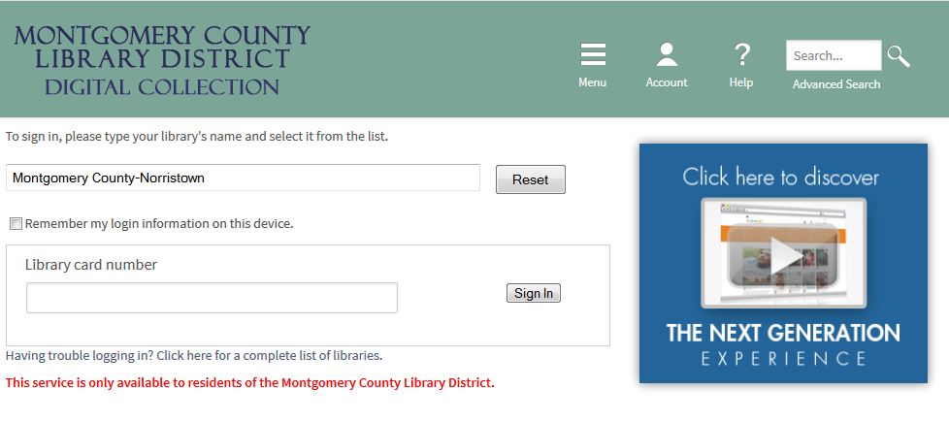
Enter your library card number and click Sign In.
Notes:
You will be taken to the home page for Montgomery County Library District’s Digital Collection.

Slide 11
As soon as you sign in, you will be returned to the page you were on. Note the Sign In button now says Sign Out.
There are many different ways to browse. If one of the book jackets appeals to you, you can start right there. Let’s examine that way first. Note that some book jackets have a darker color “book” symbol in the corner and some have a lighter symbol. The darker symbol means the book is available for immediate check out. To start, focus your cursor on the book jacket.

Slide 12
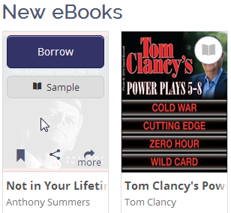
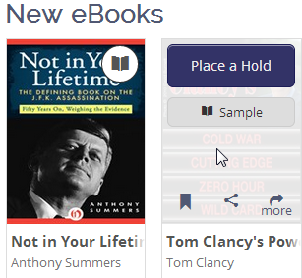
Hovering over a book jacket will reveal links to either Borrow a book or Place a Hold. Be aware that using these handy buttons does not allow you to make certain the book is offered in a format your device can read. In addition, using the Borrow button will not give you an opportunity to change the lending period. Clicking on the “more” link will take you to more information about the title, including the formats that are available.
There is a link to add the title to your Wish List.
We are going to click on the more link for the Tom Clancy book.

Slide 13
Is the book available in a format that your device can read?
Click here to place on hold.
This book is categorized in all these ways.
Click here to add to your Wish List.
How many copies does the library own? This is also where the number of holds will be listed if there are any.

Slide 14
Scroll down to see some other details such as the “Recommended for you” section.
Based on your selection, OverDrive anticipates other titles you might enjoy.
Click any of these boxes to expand for more information.

Slide 15
We’re going to Place a Hold on this book.

Slide 16
Once you click Place a Hold, you will be prompted to enter and confirm an email address for notification.
After the first time you do this, the email address will automatically populate for future holds.
Next click the Place a Hold button on this screen.

Slide 17
You will get a confirmation notice that your hold has been placed.
Let’s click the link to continue browsing for books.

Slide 18
We are taken back to the Home page. This time we’re going to click on View more…new eBooks.

Slide 19
Since we clicked on View more from the New eBooks section, our results list will default to a sort by titles most recently added to collection.
The results list will display all of the new eBooks (9301 at this time) in the collection whether they are available or not.
The results can be filtered further according to these criteria.

Slide 20
There are two different views of the results list that you can choose. This view is the Cover view. The next slide will show you the List view.
In Cover view you can again use the cursor hover to get access to a Borrow or Place a Hold link and also there are links to add the title to your wish list or to see more details. Using the “more” link is the recommended option. Note: Clicking on the Title of the book underneath the jacket will also get you to the “more detail” screen.

Slide 21
List View - This view gives you a little more visible information such as the number of copies, the number of holds as well as the beginning of a synopsis.
Clicking on the book jacket from the List view will take you to the more details screen.

Slide 22
When you begin browsing, it is very important for you to filter by the formats you are able to read on your device. Unless you have filtered by format, using the Borrow or Place a Hold buttons can lead to selecting a book that is not available in a format you can use.
We’re going to filter by EPUB format since we will be reading this on a non-Kindle device.
You can also filter results by whatever device you have.

Slide 23
You can choose to filter your search further by subject.
We’re going to click on Mystery to apply that filter.

Slide 24
Notice that my results are still New eBooks but the number of books is significantly less.
You can apply other filters to your search if you wish. Maybe you’d like to filter this search by a rating. If you open the rating menu, you’ll find the ratings filters. I’m going to filter by 5 star ratings.
Browsing this way is comparable to looking at the new books section of your library. Just remember that date added to site does not mean newly published. You can change your sort to release date to get a listing of the most recently published.

Slide 25
I’ve just filtered my search by ratings for 5-star books. A word about ratings…
Books are rated by the patrons using our digital collection and the ratings are very subjective. You have the ability to assign a rating to a book once you have signed in.

Slide 26
Notice that there are 3 applied filters – format, subject and rating. Either or both may be removed by simply clicking on the x.
Our results list is now 78 titles but not all are available. To further filter for only available titles, click the Available Now link.

Slide 27
It might be tempting now to click the Borrow button for a book we want. After all, we have filtered our search for formats that we can read. However, if we use the handy button, we will lose an opportunity to change the lending period if we so wish. The lending period will automatically become the one we have indicated in our global account preferences. If you wish to change the lending period, you should click on the book jacket in order to get to the screen where all the book details are listed.

Slide 28
Having clicked on the book jacket, we can now note that the book can be borrowed for 14 days. You can change the lending period, if you want, by clicking on “(Change your lending period)” If you change the lending period for this item, that becomes your new default lending period.

Slide 29
We are taken to a Settings screen which is part of our account. We can change the lending period to 21 days instead of 14 by clicking on 21 days. Note that this changes the lending period for all our eBooks going forward.
Finally, click Save.

Slide 30
The lending period is changed and we are ready to click on the Borrow button.

Slide 31
Once you click the Borrow button, your book will appear on the Bookshelf in your OverDrive account. All other books that are currently checked out will also appear.
Note that all of our books also have a Read (in your browser) button . This means that no software would need to be installed in order to read your book. Several screens will have a link at the very top to read about this functionality.

Slide 32
For our book, we now need to select a format to download. Note the link to Return Title in case you decide you don’t want to borrow a book after all. The option to return from this Bookshelf is not available once you download the book. (Note: Neither an Open EPUB eBook nor an Open PDF eBook have a return early option.)
We’re going to select Adobe EPUB and click the Confirm & Download button.

Slide 33
After clicking Confirm & Download, the Bookshelf view changes slightly to indicate that our book has been downloaded in the EPUB format. We can also see the loan expiration date (and time!)

Slide 34
We’re going to look for more books. Click on the large link to get to the Home page.

Slide 35
We can start browsing by selecting one of the list categories in the dark blue menu. Notice that under some categories, e.g. eBook Fiction, there is a View more link. This will display all the fiction categories in the Cover View.
The additional fiction categories that will be revealed are Historical, Juvenile, Literature, Mystery & Suspense, Romance, and Science Fiction & Fantasy.
Click View More.

Slide 36
This is the result after scrolling down to view more categories. Scroll down further to see the other categories.

Slide 37
We can now see the Romance and Science Fiction & Fantasy categories.
Notice that the 5 titles visible in each category are all available. To see all the titles in a category, click View more in the Science Fiction section…

Slide 38
Select the Cover view if it is not already selected.
We can browse through 1076 titles, some of which are available.
To view only available titles, click the Show me… Available Now link.

Slide 39
You can change the sort by expanding the Sort By menu and clicking on a different selection.
We’re going to take a closer look at this Jon Scieszka by clicking on the book title underneath the book jacket.

Slide 40
When you are in the more detail view of a title, you can view all of the other titles by the same author by clicking on the author’s name.

Slide 41
Other Jon Scieszka titles
Next, click on Account.

Slide 42
There are 4 sections of your account: Bookshelf, Holds, Lists, Settings. You will always land on the Bookshelf section when you access your account. The Bookshelf will display every book that is currently checked out. The expiration date and time will display for each. A return title button will display if you have not already downloaded the title. Once a title has been downloaded in a specific format, it cannot be returned from this page.
Next, click on Holds.

Slide 43
In the Holds section, all the titles that you currently have on hold will display. You can see your position on the waiting list. You can remove a hold if you are no longer interested in waiting for the title. You can also edit the email address that is used for notification.

Slide 44
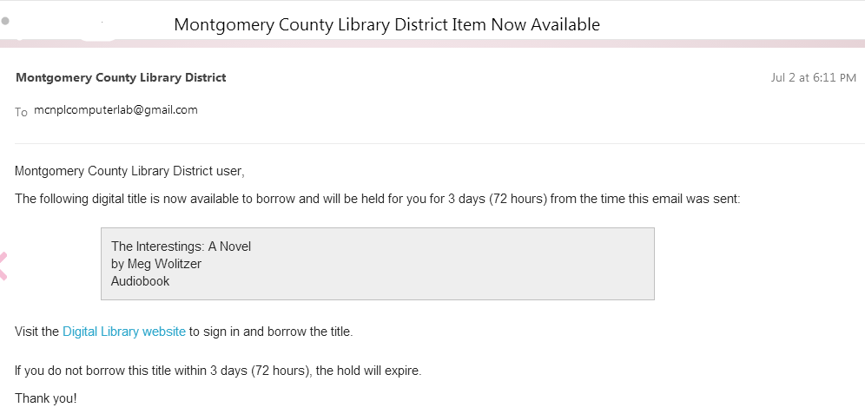
This is a sample of the email sent when a held title becomes available. The title will remain available to you for 72 hours from the time that the email was sent.
There is a link in the email to Overdrive’s website. Once there, you will need to Sign In, click on the Account link and then Holds.

Slide 45
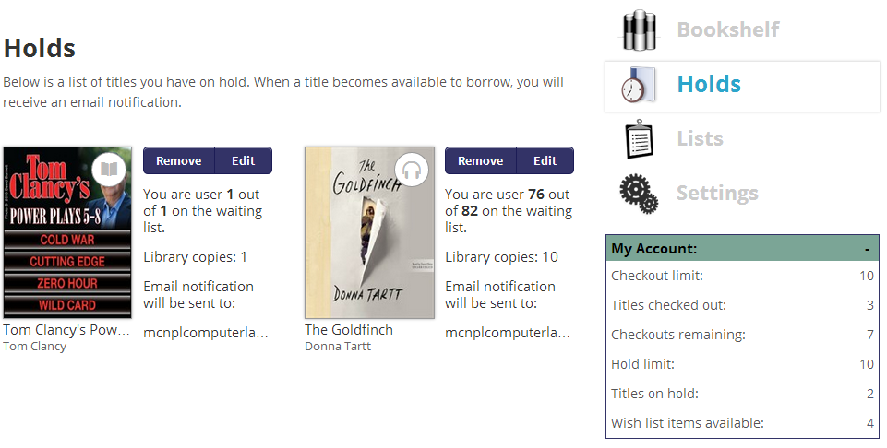
Once a title becomes available, a Borrow button will replace the Remove and Edit buttons.
There will be a notification of your lending period. (If you want to change it, you will have to click on the book title to view details.) Once you click the Borrow button, the title will move to your bookshelf. You will then be able to download it.

Slide 46
Next, click on Lists.

Slide 47
There are three types of lists:
Wish List
Rated Titles
Recommended for you

Slide 48
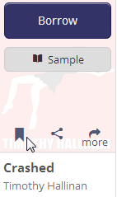
Wish List - Add titles to your wish list to save titles that you might be interested in borrowing later, including titles that have not yet been released. When you are looking at your wish list, you can borrow titles that are available or place a title on hold.
When you are browsing, you add a title to your wish list by clicking on the gray banner that appears when you hover over the book jacket.
This view shows all titles on your Wish List. Click on the Available now link to view only titles that can be borrowed immediately.

Slide 49
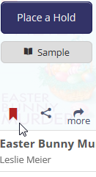
Click on the Lists link to get back to the menu of Lists.
Even after you borrow a title , it will still remain on your wish list until you physically remove it. To remove it, hover over the book jacket and click on the red banner.

Slide 50
Click List to get back to the menu of lists.
Rated Titles list - This will be a list of the titles that you personally have rated. To remove a title from this list, click Remove rating.

Slide 51
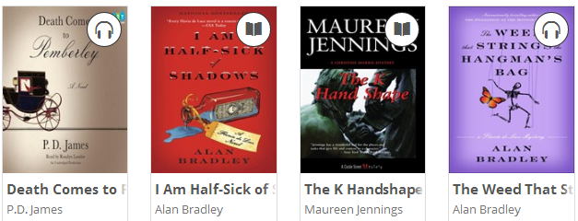
Recommended for you - a list of titles that draws from other titles that you have borrowed or are on your wish list. These titles will always be changing and all will be available to borrow immediately. Note however, that some of the titles are audiobooks.
Next, click Settings.

Slide 52
On Settings, you can change your lending periods for eBooks and Audiobooks. You can also change the Contrast of the display of the OverDrive website. Don’t forget to click the Save button to save your settings.

Slide 53
When you are finished, don’t forget to Sign Out of OverDrive.

